Slide 1
16th, 17th, 18th Century Social History

Slide 2
By the end of today you should be able to answer
What changes occurred in marriage and the family in the course of the 18th century
What was life like for children and how did attitudes toward children evolve
What did people eat and how did changes in diet and medical care affect people.

Slide 3
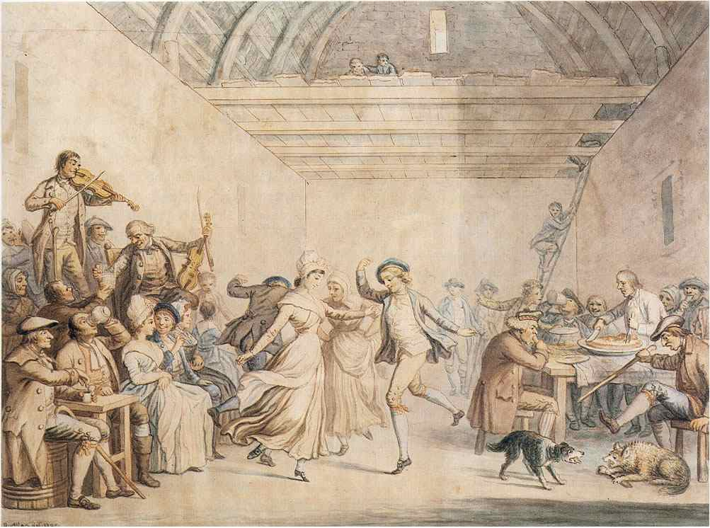
Marriage and the Family
Family Structure:
Nuclear
Marriage age:
Late 20s (economics)
Community regulation
Premarital Sex
Common
But low illegitimacy rates (1700-1750)
Community controls and pressure
Birth Control
Coitus Interruptus
“mechanical” means (condoms)
The Illegitimacy Explosion (1750-1850)
Cottage Industry
Urbanization
Marry for love

Slide 4
Family Economy
Father head of the household
Death often brought disaster
Quick remarriage
Rise of “step” children
Everyone in the household worked
Women maintained the household
For women, marriage was an economic necessity

Slide 5
Women during 18th century
Marriage was a necessity
Survival would be very difficult without it
There was little value for a women at home
Migration would be made bc of need for dowry
Would take as many as 10 years to accumulate
What is the effect in terms of marriage?
Many served as wet-nurses
The use of wet nurses was a necessity for both the mother and the wet nurse

Slide 6
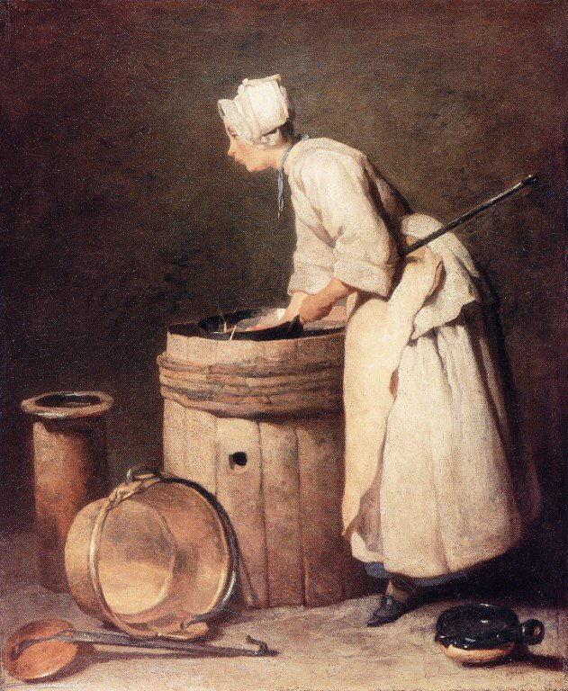
Children and Education
More formal education
(post-1750)
Led by Prussia
Infanticide
Birth not always welcome
“Overlaying”
Foundling Homes
1/3 of all babies in Paris by 1750
50-90% mortality rate
Attitude towards children
Pre-1750: indifference, discipline
“Spare the rod, spoil the child”
Post-1750: more caring and nurturing
Rousseau, Emile

Slide 7
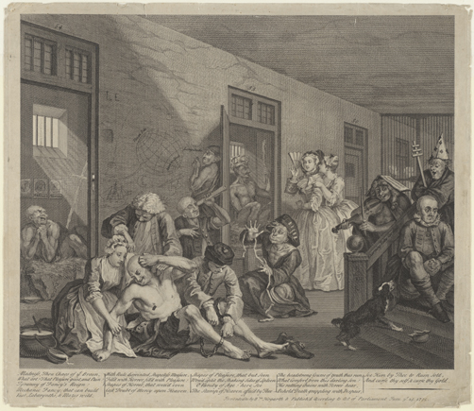
Food and Medicine
Diet
BREAD
The Poor
Vegetables and bread
The Potato
Upper Class
Meat
No vegetables
Northern Europe ate better than Southern
Medicine
Purging and bleeding
No sanitation
Hospitals and Institutions
Smallpox
Lady Montague
Edward Jenner

Slide 8
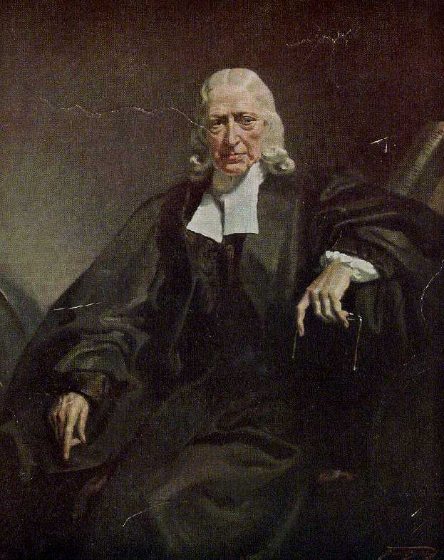
Religion and Popular Culture
Religious Revival
Pietism
Newfound religious vigor
Very evangelical
Wesley and Methodism
Catholic Piety
Festivals
Carnival
Outlet for social frustration
Entertainment
Blood sports

Slide 9
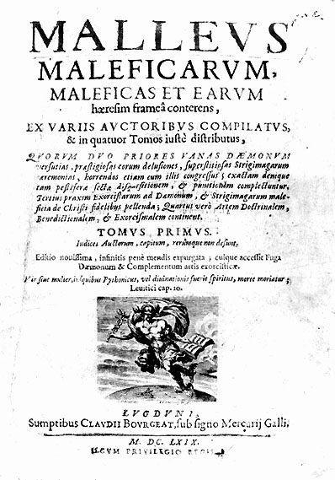
Witchcraft
The Malleus Maleficarum (1486)

Slide 10
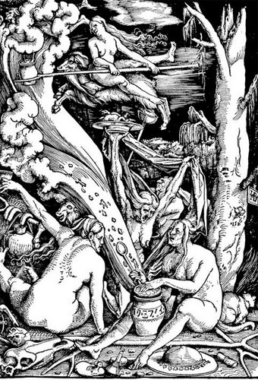
The European Witch Craze (1500-1650)
Suspects
Unmarried women
Widows
midwives
Reasons
High religious anxiety / religious wars
Increased local control
Influence of magic
Decline
Rise of the Enlightenment
End of religious wars

Slide 11
Why the Craze?
Attempts to maintain old traditions and culture, even among the learned
“Cunning folk” and the use of magic
Influence of the clergy
Encouragement to fear demons
Fueled by misogyny
Women were challenging the old order, men used this as a way to push back

Slide 12
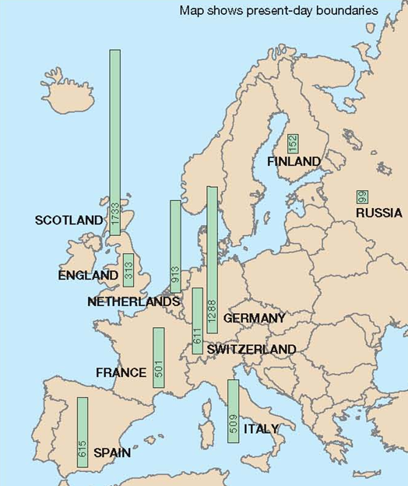
Witchcraft Persecutions

