Slide 1
Ancient Greece
The Foundation of European Society

Slide 2
Bell Ringer:
What are some of the causes of war in the world today? Write 3-4 sentences explaining your answer in your notebook.

Slide 3
Main Ideas for Today’s Lecture
As Greek city-states grew, they developed different types of government, including an early form of democracy.
Competition among the Greek city-states led to conflict.
Greek thinkers, artists, an writers explored the nature of the universe and the place of people in it

Slide 4
Key Terms (Do not write them yet)
Monarchy
Aristocracy
Oligarchy
Democracy
Persian Wars
Logic
Rhetoric

Slide 5
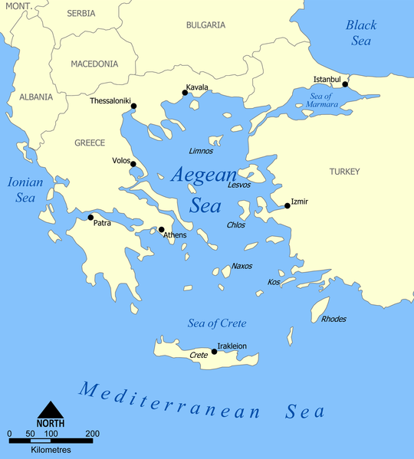
Early Greek Settlement
Mycenaean Civ.
Minoan Civ.

Slide 6
Brief Overview of Early Greek Civilization
Minoans were an early civilization that focused on trade in order to grow and prosper
Suddenly disappeared and archeologists are unsure why.
Mycenaean civilization was centered on the mainland where several city states were ruled by a single warrior-king
Best known for the Trojan War

Slide 7
From Monarchy to Democracy: Government Transitions
The early Greek city states underwent many different forms of government depending on what their city state needed to benefit the most.
Monarchy:
power is centralized through a king or queen
Aristocracy:
The rule by a landowning elite. How did they gain power?
Oligarchy
Power is in the hands of a small powerful elite group of people, usually a business class
Democracy:
Government by the people
Which of these forms of government do you feel is most effective?

Slide 8
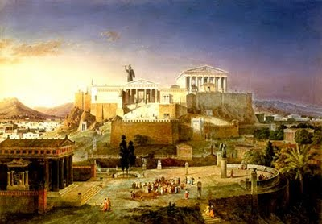
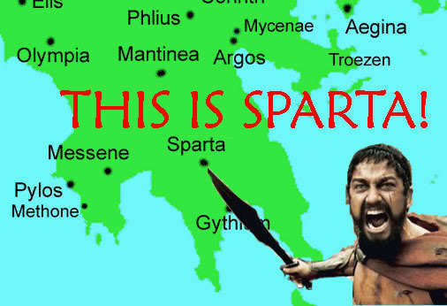
Two contrasting City States
Sparta: A military state which depended on warrior society in order to prosper
Athens: a city state that flourished in the arts and developed a limited democracy which allowed citizens to participate in government.

Slide 9
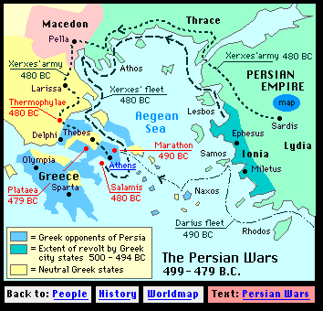
Conflict in the Greek World
The Persian Wars (490 B.C.-479 B.C.) brought years of conflict into the previously prosperous Greek world.
Some city states united to defeat the powerful Persians
Athens came out as the most powerful city state in the Greek world and soon became the center of a new empire

Slide 10
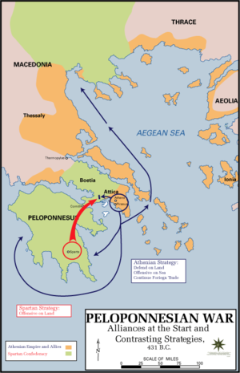
Conflict Continued
The Peloponnesian War
Athens’ growing power led to resentment within other city states, including Sparta
The Greek city states broke off into two different groups
Sparta, with the help of Persia, defeated Athens
What is the significance of Persia helping Sparta?

Slide 11
Transition from Chaos to Culture:
Culture in Ancient Greece and its Impact on Future Europe

Slide 12
Review Question
From what you already know, what is Ancient Greece known for?

Slide 13
Greek Philosophy
Many of the ideas that we hold about society today hold their roots in ancient Greek philosophy
Greek philosophers used logic (rational thinking) and rhetoric (the art of skillful speaking) in order to figure out answers to the questions that surrounded them
Socrates, Plato, and Aristotle were 3 of the most famous philosophers that revolutionized European thinking for centuries.

Slide 14
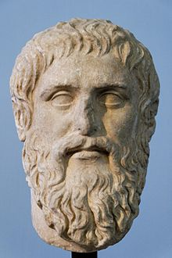
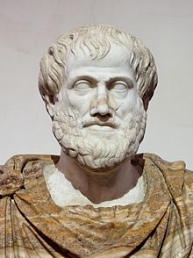
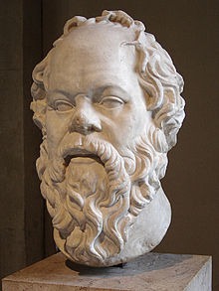
Greek Philosophers
Socrates
Aristotle
Plato

Slide 15
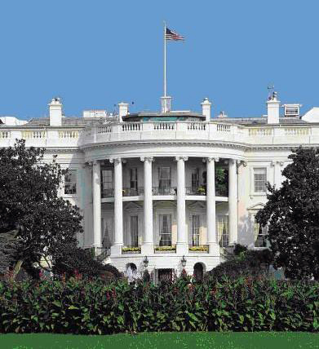
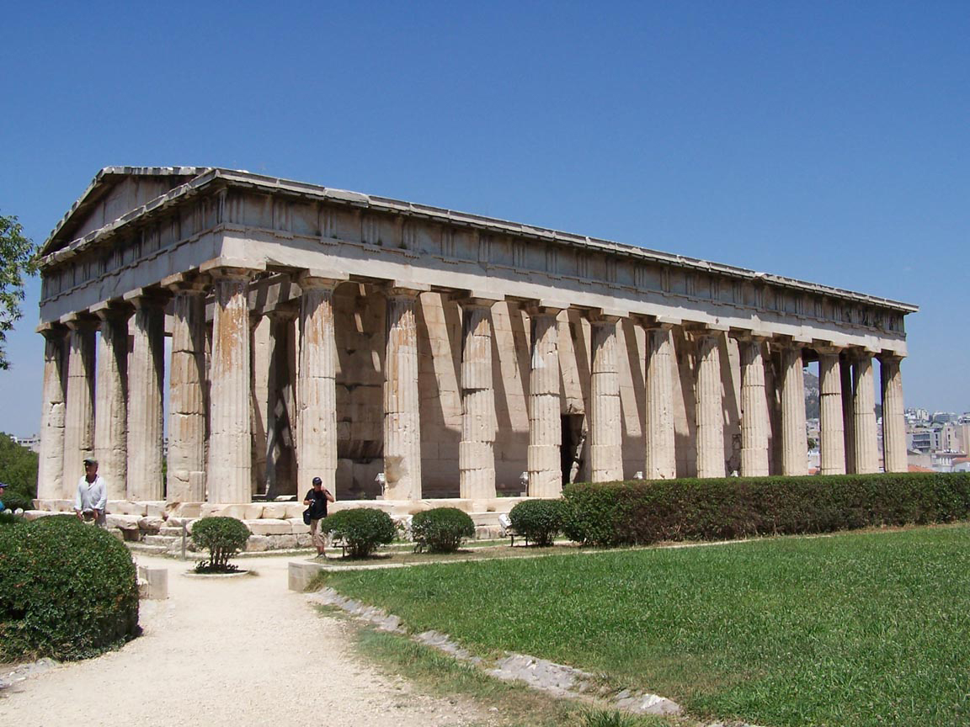
Architecture and Art
What is the similarity?

Slide 16
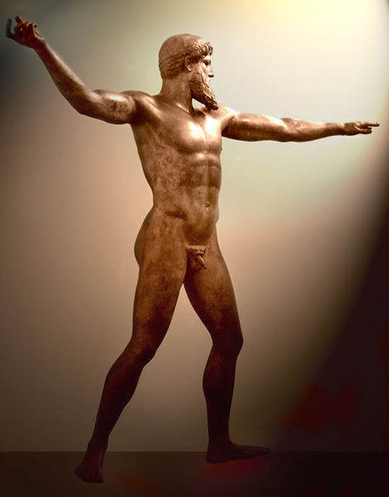
460 BCE Almost 2500 years old. Made of Bronze

Slide 17
Poetry and Drama
Tragedies: plays that told stories of human suffering that usually ended in disaster.
Why would these kind of stories be written?
Comedies: Humorous plays that mocked people or customs

Slide 18
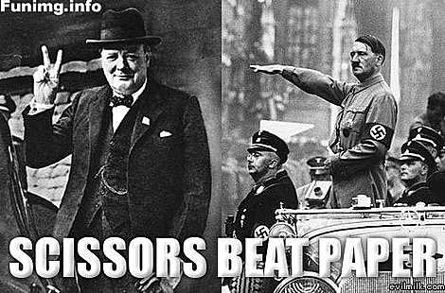
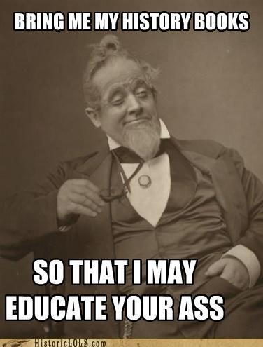
History!

Slide 19
Bell Ringer
In your notebooks, write 2-3 sentences explaining what it takes to be remembered as “great”.

Slide 20
Alexander the Great and the Hellenistic Age of Greece
Consolidation of the Greek City States and age of Empire

Slide 21
Clarification:
The “Hellenistic” age in Greece refers to the time of Alexander and the time during which Greece was an “empire”
What does it mean to be an “empire?”
The “Hellenic” age in Greece refers to the time before Alexander the Great

Slide 22
Main Ideas
Alexander the Great created a large empire and spread Greek culture throughout the region
Alexander’s unified civilization allowed for the flow of ideas to spread throughout Europe, eventually influencing all of the future civilizations that would develop.

Slide 23
Key Terms
Phillip of Macedonia
Alexander the Great
Hellenistic Civilization
Stocism
Fall of the Greek Empire

Slide 24
Path toward Civilization
Phillip of Macedonia came to power at a time when the rest of Greece was not at the peak of its power and influence
Recall: What was occurring in Greece before this time?
Through cunning leadership, a strong army, and a bit of luck, Phillip was able to conquer all of Greece and set his eye on Persia but was assassinated before this goal could be reached.
Phillip’s son Alexander took over the throne after his death

Slide 25
https://www.youtube.com/watch?v=mdE-07GHnnc

Slide 26
Alexander’s Conquests
Alexander also benefitted from a bit of luck because he was able to conquer Persia when it was at its weakest.
Alexander’s Empire stretched to three different continents (Africa Europe and Asia) and allowed for the spread of different cultures across a tremendous tract of land.
Alexander died suddenly of a fever and his empire was eventually split in three.

Slide 28
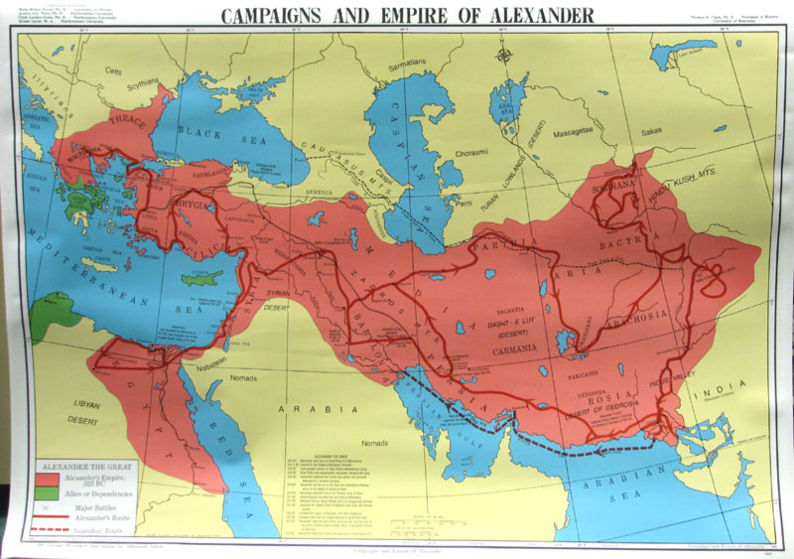

Slide 29
Legacy of Alexander
A blending of cultures
The empire extended through many different parts of the known world, leading to a blending of different customs
Spread of Hellenistic Culture
Stoicism called for the need to avoid desires and disappointments by accepting calmly whatever life brought.
Do you think this was an appropriate way to live at this time?

Slide 30
Fall of Greek Empire
After the death of Alexander, there was not a leader who could regain control of the entire empire, leading to a loss of power and influence.
By 130 BC, Rome had began to gain influence in areas where Greece formally reigned.
Rome would be the next great empire.

