Slide 1
Bell Ringer
In your notebooks, write 3-4 sentences explaining what you already know about Rome and Roman history.

Slide 2
By the end of this unit you should be able to:
Identify the transition from the Roman Republic to the Roman Empire
Identify the key characteristics of Roman society including the lives of women and children
Identify and analyze when, why, and how Rome rose to the peak of its power, along with the reasons for its future decline in power.
Identify the rise of Christianity along with having an understanding of other monotheistic religions.
Similarities and differences to the Greek civilization

Slide 3
Just for Clarification
The history of Rome can be broken down into two different time periods
Roman Republic
During this time, government officials were elected by the people. This was done in order to keep people from gaining too much power.
Roman Empire
This occurred after the Republic, it was a time where Rome was led by one ruler (eventually it would be ruled by two rulers)
Where else have we seen this type of transition in government?

Slide 4
Origins of the Roman Republic

Slide 5
Main Ideas
The Roman Republic was founded around 509 B.C. with a government that allowed some of its officials to be elected by the people
Patricians and plebeians competed for power, with the plebeians eventually gaining some influence in the government
Rome expanded quickly under the Roman Republic

Slide 6
Key Terms
Republic
Patricians
Plebeians
legion

Slide 7
Roman Republic Origins
The ancestors of the Romans, the Latins, settled into italy around 800 B.C.
Greek colonists settled into the area of southern Italy
Why is this significant?

Slide 8
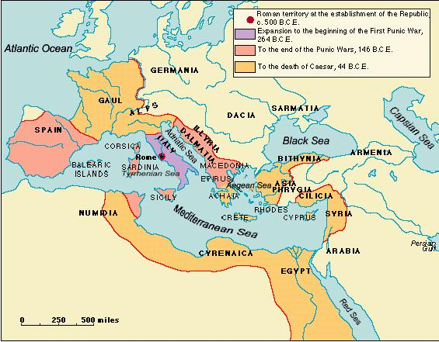
Roman Geography
What are some of the things that you notice from this map?

Slide 9
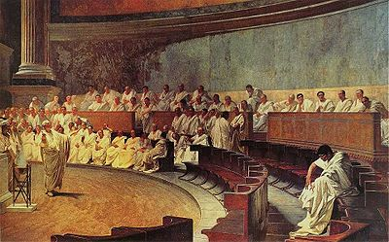
Rome was a Republic (at first)
A republic is a form of government where people elect representatives.
The United States has a representative government. We learned about this form of government from the Romans.

Slide 10
Development of Government
Patricians were part of the landholding upper class who initially held all of the power in the Roman Republic
what form of government does this resemble?
Plebians were farmers, merchants, artists, and traders who made up most of the population. They fought hard to gain more rights and would eventually be allowed to sit in the senate
Why is this important?

Slide 11
Structure of Government
Senators were citizens who served in the governing body for life. They elected consuls, whose job was to supervise the government and command the armies. The senate could elect a dictator in the event of war.

Slide 12
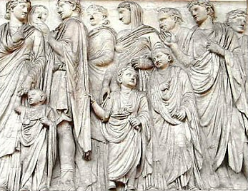
Society and Expansion
Women had a much larger role in society than their Greek counterparts
Girls and boys were taught to read and write, even some in the lower classes.
Why is this important?
What do you see here?

Slide 13
Transition to Empire
From what you already know what is the difference between a republic and an empire?

Slide 14
Roman Goals
Romans were committed to a policy of imperialism.
What does this mean?
How would they accomplish this?
Where have we seen policies of imperialism before?
What will happen as a result of the policy of imperialism?

Slide 15
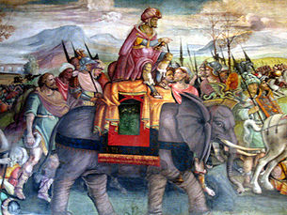
The 3 Punic Wars
The Punic Wars were fought against Carthage and ended with the Roman civilization defeating Carthage and growing its empire into Africa.

Slide 16
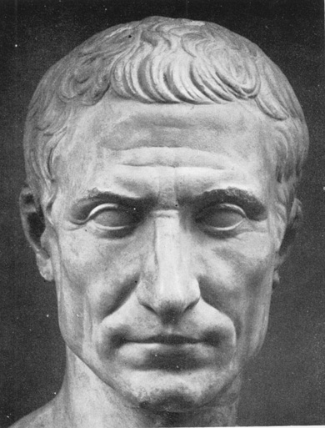
Civil War and the Rise of Empire
Julius Caesar was able to take advantage of the political turmoil in Rome and forced the senate to make him a dictator.
Marked the beginning of the Empire
Caesar would eventually be assassinated by his rivals

Slide 17
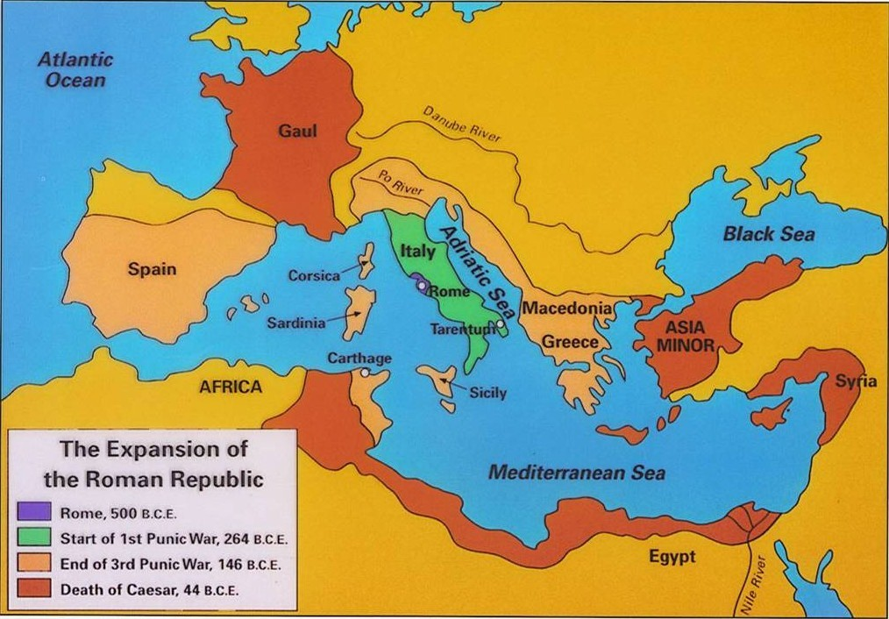

Slide 18
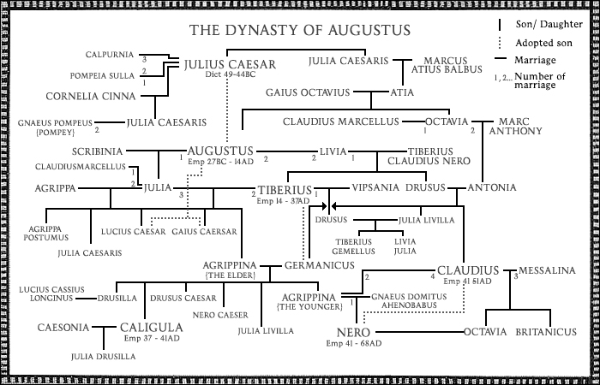

Slide 19
Assassination of Caesar Activity
For the following pictures, work with a group of no more than 4 in order to answer the following questions.
Does Julius Caesar look like someone who deserves to be murdered? Explain your response
Which picture do you feel is the most accurate representation of his murder?
What bias do you see in the pictures?
Write your answers on ONE sheet of paper. Put everyone’s name on it.

Slide 20
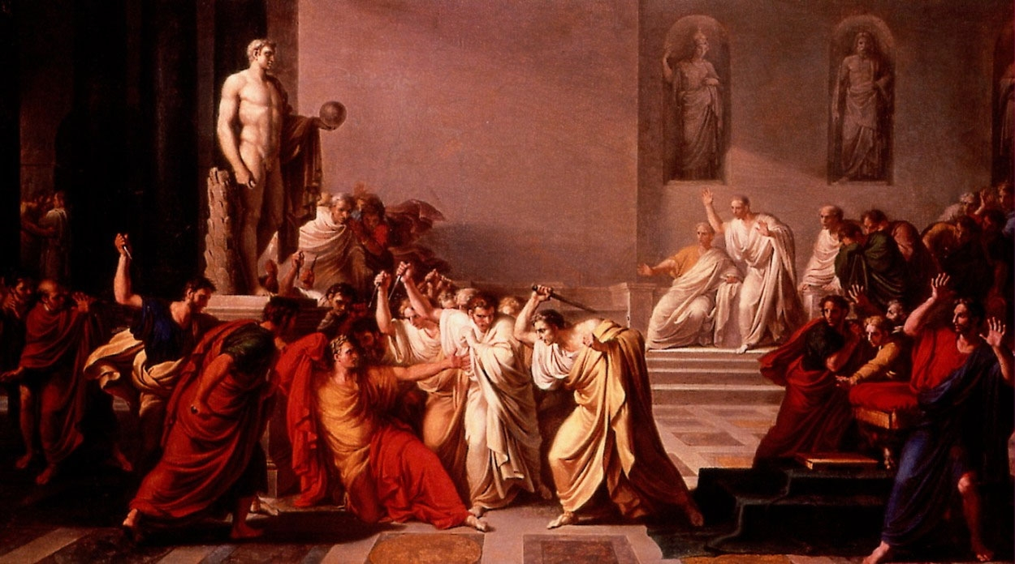

Slide 21
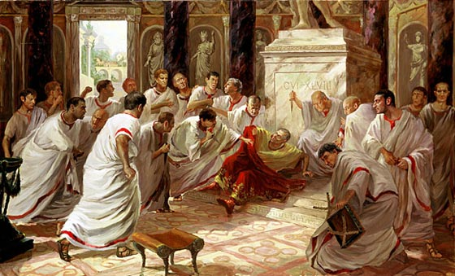

Slide 22
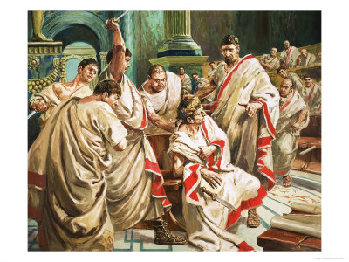

Slide 23
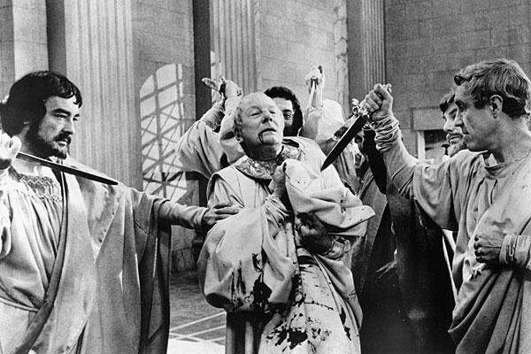

Slide 24
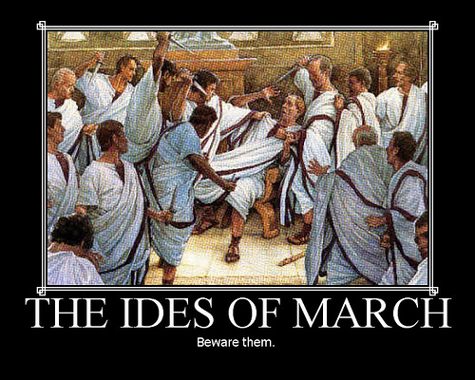

Slide 25
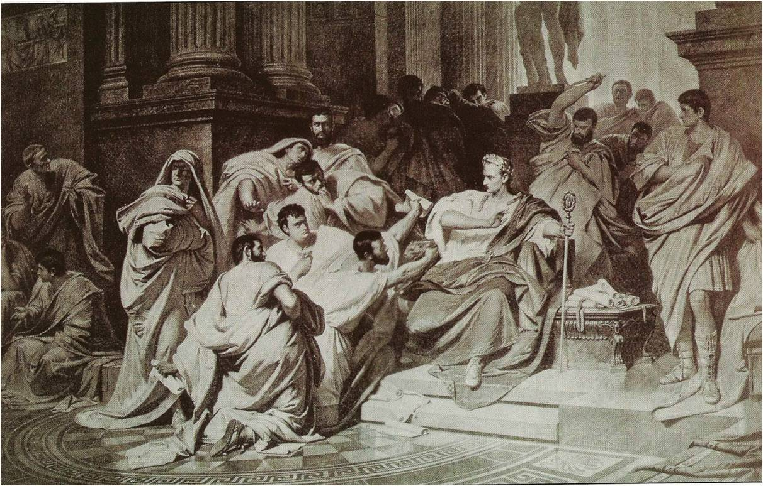

Slide 26
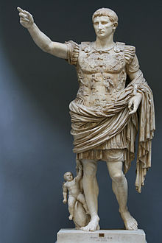
Second Civil War and Augustus
After Caesars assassination, there was a second civil war, ending with Augustus being named princeps by the senate.
What does this mean?
How is this definition significant?
Augustus’ rule began a 200 year period known as the Pax Romana
What does this mean?

Slide 27
Roman Successes
Much like the Greeks, Romans made great strides in the development of their culture
What were Romans famous for?

Slide 28
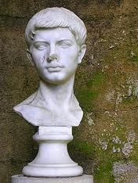
Literature Philosophy and History
Roman historians such as Virgil sought to take a detailed account of Roman history.
Why should we care?
Romans also adopted many Greek philosophies such as Stoicism and Platonism and incorporated them into their lives

Slide 29
Technology and Science
Aqueducts https://www.youtube.com/watch?v=oTMrfyAt6Mo
Toilets (Warning) https://www.youtube.com/watch?NR=1&v=6snVyK6gQCE&feature=endscreen

Slide 30
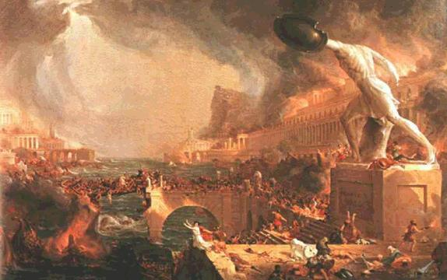
Decline of Rome
What in the world happened?

Slide 31
On a separate sheet of paper.
Write 5-6 sentences explaining what is needed by a civilization in order to maintain stability.
Write 4-5 sentences explaining what can cause a civilization to lose its power and get wiped out.

