Slide 1
Bell Ringer
Take three minutes to write everything you know or have heard about the Middle East

Slide 2
Intro to the Middle East

Slide 3
What is the Middle East?
Complex definition
Why?
It is not a specific continent, like Africa, North America, or Europe
The label of “Middle Eastern” is too broad to be used as a generalization for what type of person someone is
Composed of four distinct culture areas
Arab
Turkish
Iranian
Israel
These are more accurate representations for who these people are.

Slide 4
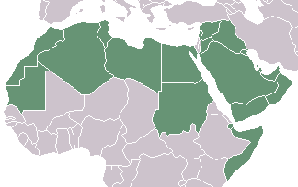
Arab World
Speak Arabic
Traditionally Islamic (Muslim)
We will focus more on Islam in the coming days

Slide 5
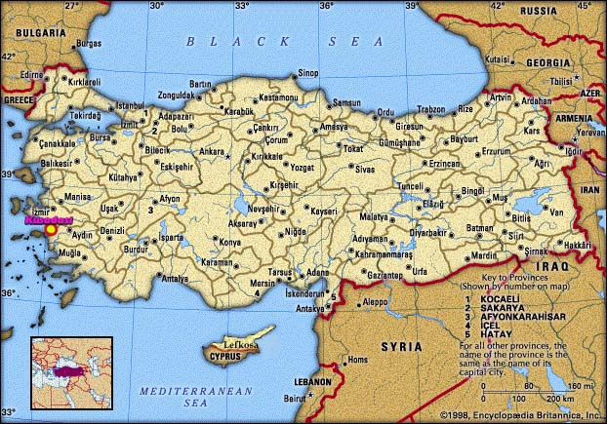
Turkey
Most people identify themselves as Turkish
Most are Muslim
European or Middle Eastern?

Slide 6
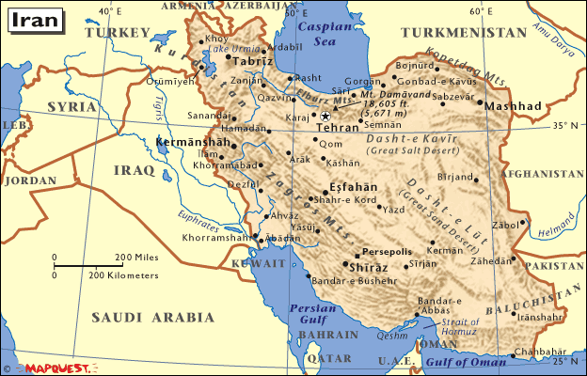
Iran
Most people consider themselves to be Iranian or Persian
Persian is the most widely spoken language
Most are Muslim

Slide 7
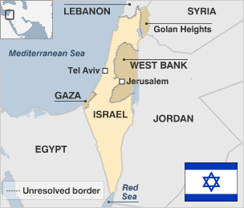
Israel
Even more complex
Most are Jewish
Many are Muslim
Hebrew and Arabic are official languages
Issue of Palestine

Slide 8
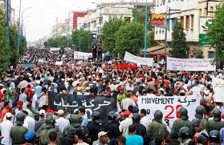
What are some issues found within the Middle East?
Religious tension
Political instability
Competition for natural resources

Slide 9
Religion in the Middle East

Slide 10
Monotheistic Religions
Monotheistic religions preached in the existence of a single god, unlike polytheistic religions, which believed in many gods.
Judaism (~1300 B.C.)
Christianity (34 AD)
Islam (622 AD)
Zoroastrianism? (~600 B.C.)

Slide 11
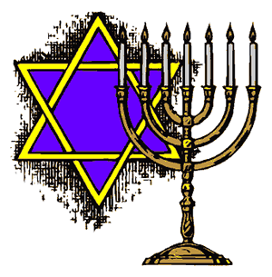
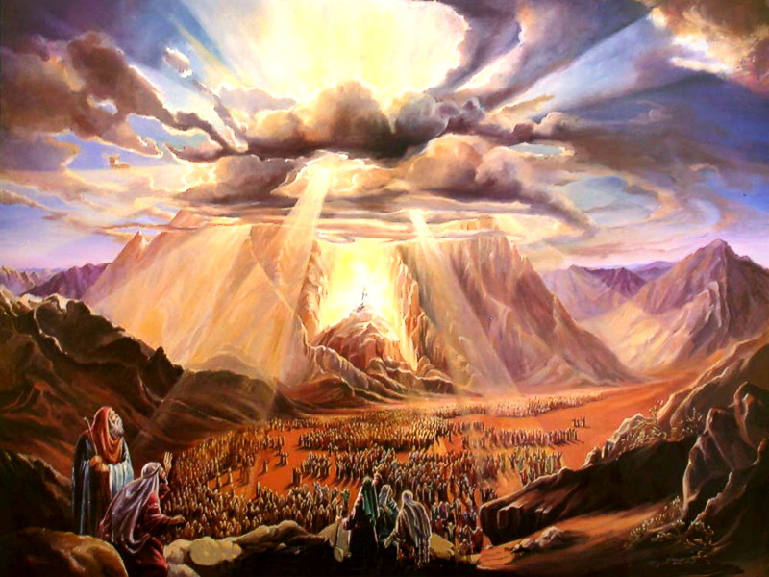
Judaism
Tenets
Obedience to God
Obey the law and atone for sin
Holy book-Bible (Old Testament)
God- Yahweh

Slide 12
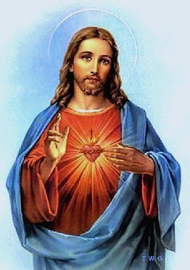
Christianity
God= Jesus Christ
Holy book- Bible and New Testament
Largest religion in the world
Major tenet:
“know, love, and serve God”

Slide 13
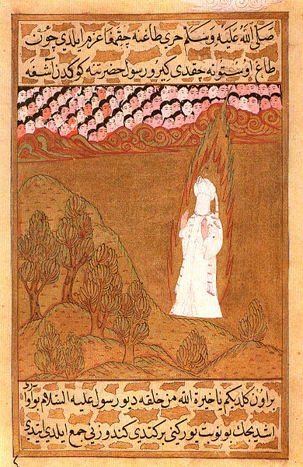
Islam
Founder- Muhammad
Muhammad= the last prophet according to Muslims
God= Allah (god in Arabic)
Qur’an (Koran)- holy book
Five pillars of Islam
Belief
Worship
Charitable giving
Fasting during Ramadan
Pilgrimage to Mecca (hajj) to visit the Ka-bah

Slide 14
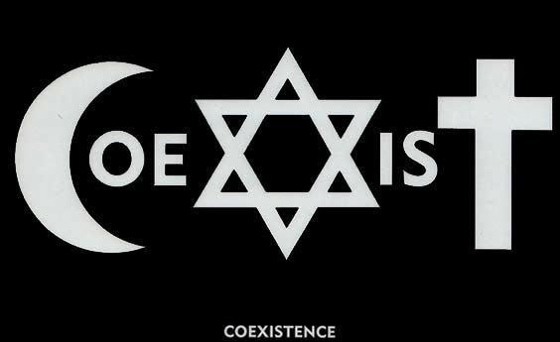
Commonalities between Religions
Abrahamic Religions
All follow reference to Abraham and God made in Hebrew bible
Jerusalem
Holy city for all three religions
Idea of heaven

Slide 15
Rise of Islam in the Middle East
In your notebooks, write four sentences explaining what is required for a religion to grow and spread.

Slide 16
Main Ideas
Islam arose in the Arabian Peninsula and became one of the world’s major religions
Arab armies were inspired by Muhammad’s teachings and spread through parts of three continents

Slide 17
Key Terms
Hijra
Jihad
Caliph
Sunni
Shiites
Abbassid golden age

Slide 18
Life after Muhammad
Split within Islam
Why?
Questions of his successor
Sunni
Abu-Bakr (father in law) is successor
Successors follow the example of Muhammad
Shiite
Ali (son in law) is true successor
Successors are divinely inspired because they are descendents of Muhammad

