Slide 1
Modern Middle East

Slide 2
Reactions to Western Influences
West
mandates
oil
cold war
Israel
Arab Nationalism
Islamic Fundamentalism

Slide 3
the Arab World

Slide 4
Arab Nationalism
Arab unity
Pan-Arabism
UAR (Egypt and Syria 1958)
Leftist, anti-Western
support from USSR
Ba’ath parties (Syria and Iraq) = dictatorships
anti-Israel
Anti-imperialism
Decline
Arab monarchies resist
Saudi Arabia, Jordan, Gulf States
National rivalries and disputes
Six-day War

Slide 5
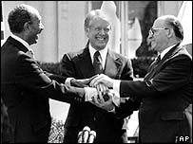
Gamal Nasser
Egyptian president
overthrew monarchy
nationalized Suez Canal
Suez Crisis 1956
becomes Arab hero
built Aswan Dam
discredited after six-day war
Dies
Succeeded by Anwar Sadat
Assassinated for peace w/Israel

Slide 6
Islamic Fundamentalism
base laws on shari’ah
Muslim Brotherhood
1920s Egypt
Saudi Arabia
Wahhabism
Anti-western
“Secular and decadent”
Iranian Rev. of 1979
Anti-communist
Afghanistan
Mujahideen vs. USSR
Taliban
Osama Bin Laden
Ayatollah Khomeini

Slide 7
Arab Spring
The pro-democracy uprisings currently sweeping the Middle East and North Africa
Led to the toppling of many authoritarian regimes

Slide 8
Causes
Increased literacy rates
Calls for democracy
Technology
Poor economies

Slide 10
Iran
Ahmadinejad = Pres.
Ali Khameini
= supreme Leader
Guardian Council = Protects Islam in iran
Allows candidates, vetoes laws, etc.

Slide 11
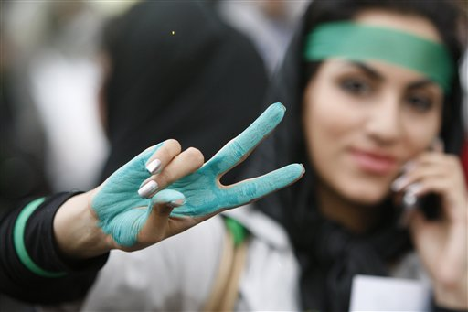
Green Revolution = 2009 Election results are disputed

Slide 13
Characteristics of the Revolutions
technology
Self-immolation

Slide 15
Egypt
Hosni Mubarak
Muslim brotherhood
Video on Repression within new
regime

Slide 17
Libya
Gadaffi
Civil war

Slide 18
Lockerbie Bombing (Pan Am 103)

Slide 19
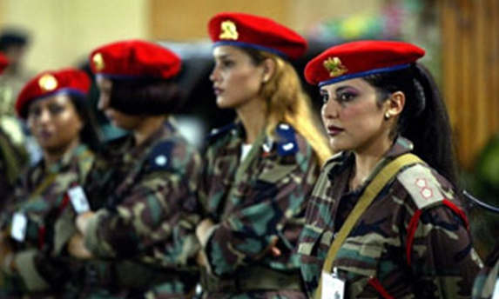

Slide 21
Syria

Slide 22
What is currently happening…
Civil unrest
Calls for democracy
Authoritarian regime
International involvement?

